Slide 1
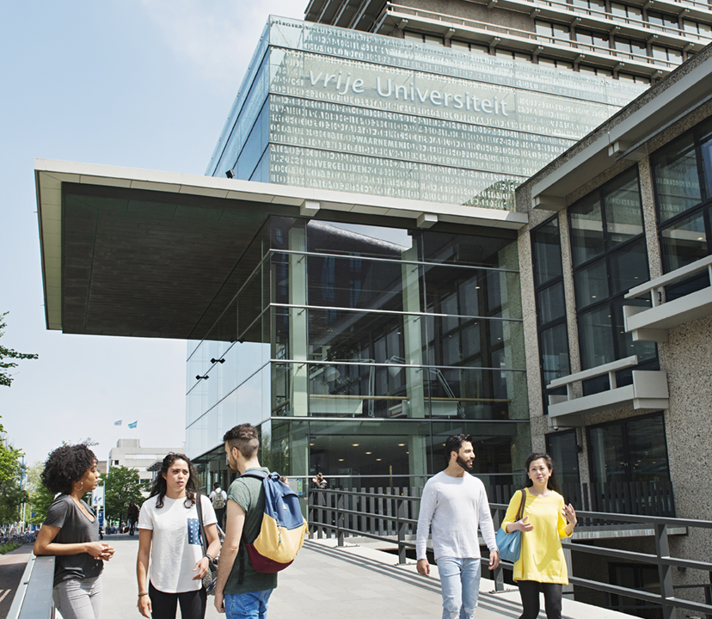
Learning Machines Task 0
Problem definition
Motivation for solving the problem
Chosen methodology
Experimental setup
The demos
Results
Conclusion

Slide 2
Problem definition
Problem definition
In Task 0 we want to analyse and test the basic movements and response of the robot.
Questions that needs to be answered are:
Can the robot learn avoiding a collision with an obstacle by stopping on time.
Can the robot turn away from the obstacle.
Does a simulation-to-reality gap occur in the experiment.
Do the sensors behave the same in simulation and real world.
Do the commands and movements align in both environments.

Slide 3
Motivation
Motivation for solving Task 0
When analysing the working of the robot and validating the alignment between the simulation and real world, it provides us the following benefits:
In avoiding an obstacle it provides us operational safety and reliability. Advancing in this will get us closer to autonomous navigation.
Ensuring that the robot behaves the same in simulation as well as in real world provides us cost-efficiency in robotics development.

Slide 4
Methodology
Chosen methodology for performing Task 0
In core, the most important concept of Task 0 is to examine the physical environment and react to it by rotation.
The selected methodology is hard-coding the move forward until an obstacle is detected, rotate and then engage follow up movement.
In this stage no advanced methodology, ie neural network, genetic algorithm, is performed.

Slide 5
Experimental set up
The experimental set up as for Task 0
The Robobo is placed in front of an obstacle. During the move forward the Robobo needs to continue until it detects an obstacle. At this point it should continue approach the obstacle until a specific distance, stop and turn to the left.
This experiment is performed x times in simulation and x times in real world.

Slide 6
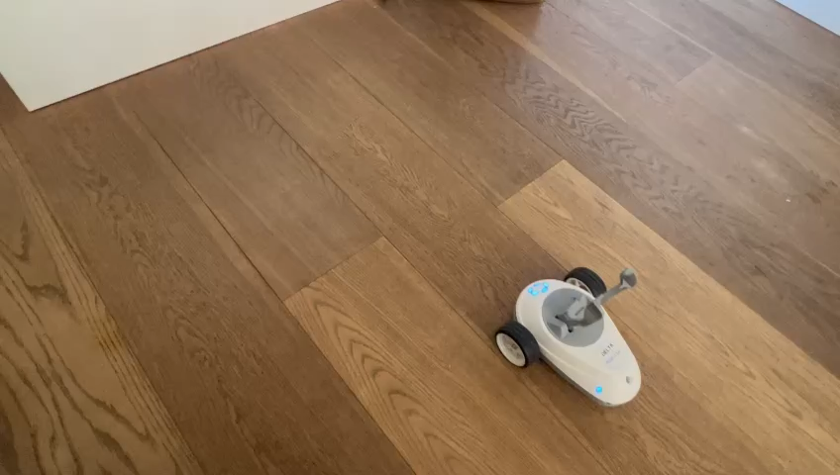
The Demos
The demo for the hardware

Slide 7
The Demos
The demo for the simulation

Slide 8
Results
Observations in hardware
x
Observations in simulation
y

Slide 9
Conclusion
Conclusion on Task 0
x

